Slide 1

COLLOQUIUM

Slide 2



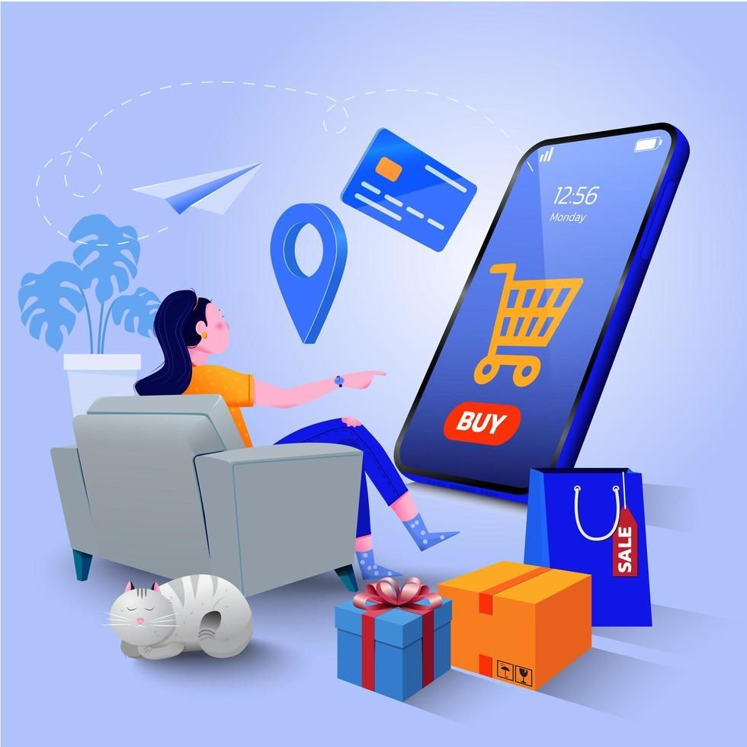
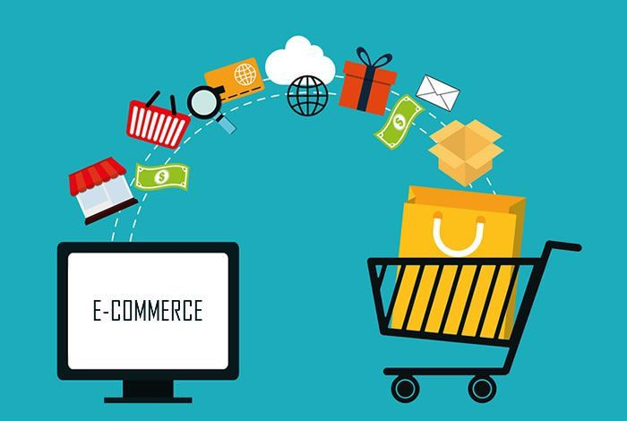
E-COMMERCE INDUSTRY
Include the sale of physical goods, digital products, and services
Buying and selling of goods and services online.
Businesses don't need to have a physical location, unlike traditional retail stores.

Slide 3
E-COMMERCE INDUSTRY
India's E-commerce Industry:
7th largest e-commerce market globally in 2022
Contributed 6.22% to India's GDP in FY2021
Projected to contribute 2.5% by FY2030
India's e-commerce platforms achieved a significant milestone, hitting a GMV of US$ 60 billion in fiscal year 2023
Global E-commerce Market:
Projected to reach $6.3 trillion in 2024 (8.76% increase from 2023)
Expected to grow at a CAGR of 1.26% between 2021 and 2025
Source: Business Standard

Slide 4
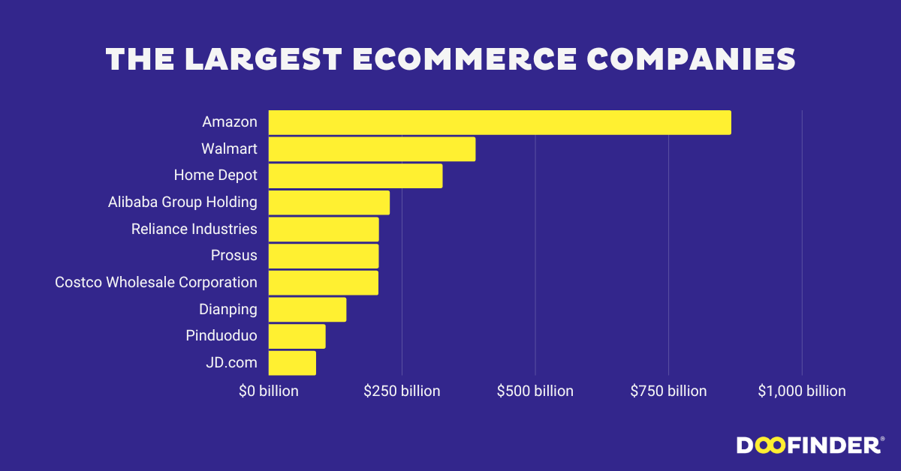
MARKET SIZE
Largest eCommerce Markets In The World (2024 Data)
China – $3.19 trillion
United States – $1.22 trillion
United Kingdom – $195.7 billion
Japan – $169.40 billion
South Korea – $147 billion
Germany – $141.2 Billion
India – $116 billion
Indonesia – $62 billion
Source: Doofinder
Source: SellersCommerce

Slide 5





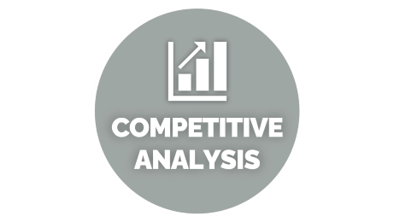

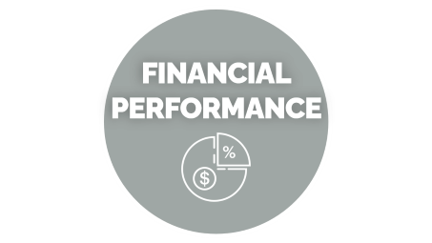
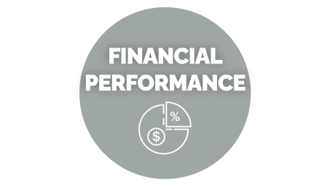

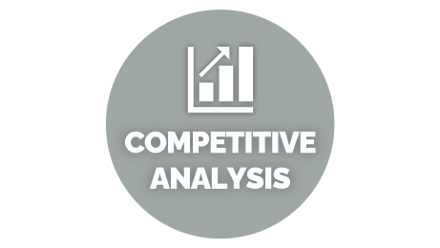



Slide 6

INTRODUCTION

Slide 7




INTRODUCTION
Founded in 2008 by visionary entrepreneurs Deepinder Goyal and Pankaj Chaddah
Platform that has revolutionized the way we find and experience food
Operates in over 24 countries
Zomato's headquarters is located in Gurugram, Haryana, India.
The Key USPs of Zomato are its extensive restaurant database, user-friendly interface, and reliable reviews.
Listed as Zomato Ltd, A market value of 2.58 trillion as of August 08, 2024
Source: zomato.com, bseindia.com

Slide 8



INTRODUCTION
Founded in 2012 by Falguni Nayar
Platform that has revolutionized the way Indians shop for beauty and personal care products.
Nykaa's headquarters is located in Mumbai, India.
The USPs of Nykaa are wide product range, data-driven approach with personalized recommendation for customer.
Nykaa has 174 physical retail stores in India.
Listed as Nykaa – Fsn E-Commerce Ventures Ltd, the maket value of 456.87 billion as of August 08, 2024.
Source: nykaa.com, financialexpress.com, bseindia.com

Slide 9

COMPETITIVE ANALYSIS

Slide 10

COMPETITIVE ANALYSIS
COMPANY | REVENUE as FY 24(cr.) | EBITDA(cr.) | MARKET CAP(cr.) | USERS(cr.)
ZOMATO | 13,545 | 372 | 272,572.00 | 5.20
NYKAA | 6385.6 | 380.7 | 48,336.00 | 3.70
PAYTM | 9,978 | 559 | 59881 | 30
INDIAMART | 1394.7 | 334 | 14181 | 1
Source: Company Annual Report

Slide 11

PESTEL

Slide 12
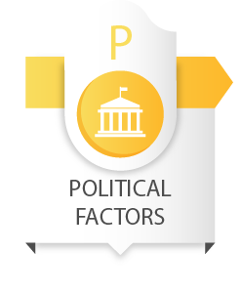
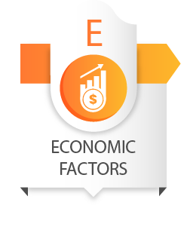

PESTEL
Trade Policies: Taxes and tariffs affect e-commerce pricing.
Government Support: Training programs and simpler rules boost growth.
Bureaucracy: Complex paperwork discourages expansion.
Inflation: High prices reduce online shopping.
Interest Rates:
High: People save more, spend less.
Low: Encourages spending and business growth.
Economic Growth: Higher incomes lead to more online shopping.
Internet & Smartphone Use: More access leads to more online shoppers.
Convenience: People prefer shopping from home.
Trust Issues: Trust boosts sales; concerns about data safety reduce them.
Source: Pestelanalysis.com

Slide 13
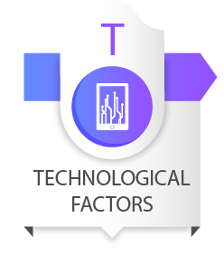

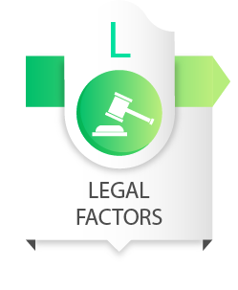
PESTEL
AI & Data:
Recommends products to buyers.
Helps businesses plan better.
Devices: Mobile phones make online shopping easier.
Payment Systems: Online payments enhance convenience.
Eco-Friendly Practices: Positive image with electric vehicles and sustainable methods.
Natural Disasters: Disrupt deliveries and sales.
Sustainability: Attracts eco-conscious customers.
Data Protection: Essential for trust and avoiding penalties.
Intellectual Property: Avoid fake products to prevent fines.
Taxes & Trade Rules: Can restrict cross-border operations.
Source: Pestelanalysis.com

Slide 14

7P’s OF MARKETING

Slide 15




7P’s OF MARKETING
Restaurant Discovery: Users can find restaurants based on location, cuisine, ratings, and more.
Table Reservations: Booking tables at partner restaurants.
Online Ordering: Users can order food for home delivery.
Zomato Gold/Pro: A subscription service offering discounts and exclusive offers.
Zomato Kitchen: Zomato is investing in cloud kitchens for online food orders, allowing restaurants to expand their reach without significant physical dining space investments.
Hyperpure: Zomato's supply wing provides fresh, high-quality ingredients to restaurants, ensuring quality control and streamlining the supply chain for partner restaurants.
Source: marketing91.com
Diverse Range: Nykaa focuses on cosmetics as its chief product category, and it has a broad range to cover all types of users.
Quality Assurance: The platform guarantees that only quality and legit products are posted on the website, thus winning customer trust.
Exclusive Launches: Nykaa always collaborates with brands for new product launches which creates a positive engagement.
Customization Options: The company also enables customers to select different product options where they can customize some of the products like lipsticks and fragrances based on their preferences.
Source: rdsdigital.in

Slide 16



7P’s OF MARKETING
Source: marketing91.com
Competitive Pricing: Offers competitive prices to stay ahead in the market, By regularly analyzing the pricing structure of competitors
Subscription Model: Charges for premium services like Zomato Pro, which offers exclusive discounts and benefits.
Delivery Charges: Additional charges for delivery based on distance, order value, etc.
Freemium Model for Restaurant Partner: For restaurants, Zomato operates on a freemium model, offering basic listings for free while charging for additional promotional and analytics services.
Competitive Pricing: Offers competitive prices to attract a wide range of customers, and aims at providing affordable products to its customers without compromising the quality.
Premium Pricing: Some high-end products are priced higher to reflect their quality and brand value.
Discounts and Offers: Regular promotions, discounts, coupons and loyalty programs to encourage customers to spend more time with the business.
Source: rdsdigital.in

Slide 17

7P’s OF MARKETING
Source: marketing91.com
Zomato operates primarily through its mobile app and website, making it accessible anywhere with internet
Global Presence: Available in multiple countries, catering to a diverse audience.
Local Partnerships: Collaborates with local restaurants to offer a wide range of options.
Technology Use for Smooth Service: The platform utilizes advanced technology like AI and data analytics to optimize delivery routes, streamline order processing, and improve customer satisfaction and service speed across various locations.
Online Store: The primary platform where customers can shop from the comfort of their homes.
Physical Stores: Over 174 stores across India, providing a tactile shopping experience.
Partnerships: Collaborations with other retailers and brands to expand its reach.
Source: rdsdigital.in

Slide 18

7P’s OF MARKETING
Source: marketing91.com
Digital Marketing: Active on social media platforms, Google Ads, and other online advertisements, and email marketing.
Influencer Collaboration: Collaborates with food bloggers and influencers to reach a larger audience.
Content Marketing: Zomato uses a unique content marketing strategy, utilizing images to engage audiences and deliver fresh, entertaining messages in a unique way.
Promotions and Discounts: Regularly offers deals, discounts, and cashback to attract and retain customers.
Digital Marketing: Active on social media platforms, influencer collaborations, and online advertisements, and email marketing.
Influencer Collaboration: Collaborations with beauty influencers, makeup artists, and celebrities amplify brand visibility.
Content Marketing: It creates useful and entertaining materials – texts and videos, blogs, guides, and reviews to enlighten and motivate the clients.
Events and Launches: Organizes events and product launches to create buzz and engage with customers.
Customer Service: Exceptional customer service to build trust and loyalty.
Source: rdsdigital.in

Slide 19

7P’s OF MARKETING
Source: marketing91.com, linkedin(Zomato)
Zomato has a team of over 5,000 people, and more than 350,000 delivery partners. As of November 2024, Zomato has 6,778 employees.
Customer Support: Provides excellent customer service to build trust and loyalty.
Employee Training: Ensures employees are well-trained to handle customer queries and issues effectively.
Nykaa has a team of over 5000 people.
Customer Support: Nykaa provides live chat, email support, and a robust FAQ section for customer queries.
Employee Training: Ensures employees are well-trained to handle customer queries and issues effectively.
Source: rdsdigital.in, linkedin(nykaa)

Slide 20

7P’s OF MARKETING
Order Management: Efficient order processing and delivery system.
Feedback System: Allows users to provide feedback on their dining experiences.
Technology Integration: Uses advanced technology for seamless operations and user experience.
Seamless Checkout: Multiple payment options, from COD (Cash on Delivery) to UPI, credit cards, and wallets, make it convenient for customers.
User-Friendly Platform: The Nykaa app and website are easy to navigate, enabling smooth product searches, recommendations, and transactions.
Technology Integration: Uses advanced AI-driven recommendations technology for seamless operations and user experience.
Seamless Checkout: Multiple payment options, from COD (Cash on Delivery) to UPI, credit cards, and wallets, make it convenient for customers.

Slide 21

7P’s OF MARKETING
Branding: Consistent branding across all platforms and marketing materials.
User Experience: A user-friendly app and website interface.
Packaging: Quality packaging for food delivery to maintain freshness and presentation.
Invoices: Email and SMS notifications on order confirmation, shipping, and delivery.
User Experience: A user-friendly app and website interface.
Nykaa has stores in three formats:
Nykaa On Trend: On Trend products are limited to trending and fashionable brands.
Nykaa Luxe: Luxe stores feature more premium and luxury brands such as Estee Lauder, Dior, Huda Beauty, and M.A.C Cosmetics among others.
Nykaa Kiosk: This is a new brick-and-mortar retail format.
Receipts & Invoices: Email and SMS notifications on order confirmation, shipping, and delivery.
Source: buildd.co

Slide 22

FINANCIAL PERFORMANCE

Slide 23
FINANCIAL PERFORMANCE
Source: Company Annual Report

Slide 24
FINANCIAL PERFORMANCE
Source: Company Annual Report

Slide 25
FINANCIAL PERFORMANCE
Source: Company Annual Report

Slide 26
FINANCIAL PERFORMANCE
Source: Company Annual Report

Slide 27
FINANCIAL PERFORMANCE
Source: Company Annual Report

Slide 28

SWOT

Slide 29

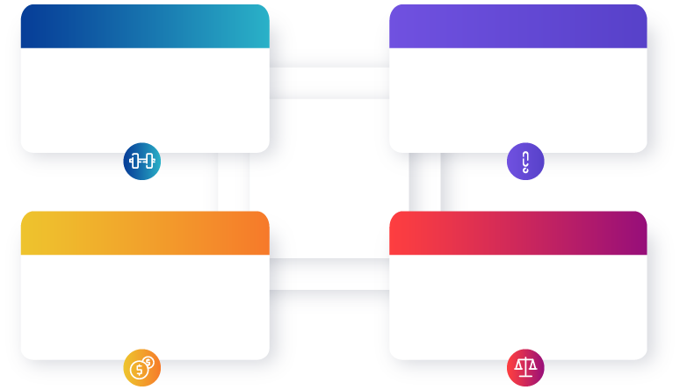
SWOT
Strengths
Weaknesses
World’s leading food delivery services site
Dynamic marketing strategies
Global presence
Operational Challenge
Management/ownership restructuring
Opportunities
Threats
Potential market growth
International Expansion
Technology and Innovation
Client shrinking margins
Security breaches
Regulatory Threats
Source: bstrategyhub.com

Slide 30
SWOT
Strengths
Weaknesses
Innovation
Affordability
Property Rights
Wide Range of Product
R&D
Decision-making Process
Poor Waste Management
Opportunities
Threats
New Technologies
Following Trends
Matching Lifestyle of Customers
Health Concern
The Rise in Competitors
Industry Regulation
Source: iide.co

Slide 31
Shreya Gajera - 2426043
Vishal Desai - 2426057
Saniya Mandiwala - 2426041
Viren Agola - 2426056
Jahanvi Parmar - 2426020
Manan Dharangadhariya - 2426028

